Slide 1
Symbolic Math Toolbox
In order to enter a transfer function into MATLAB, the variables used to contain numerical values must be ‘converted’ to store symbolic variables. This can be done with MATLAB symbolic toolbox.
Command
  syms : Short-cut for constructing symbolic objects
  All variables appearing on the right-hand-side must be symbolized.
Syntax
  syms arg1 arg2 ...
  Type ‘syms’ to see what variables are symbolized. Use ‘clear arg1’ to remove arg1 from this list.

Slide 2
1. Using Laplace Transform in MATLAB

Slide 3
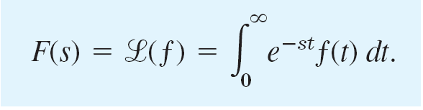
Laplace Transform
(Try typing ‘help laplace’ in MATLAB…)
LAPLACE Laplace transform.
L = LAPLACE(F) is the Laplace transform of the scalar sym F with default independent variable t. The default return is a function of s. If F = F(t), then LAPLACE returns a function of s: L = L(s).
By definition L(s) = int(F(t)*exp(-s*t),0,inf), where integration occurs with respect to t.

Slide 4
L = LAPLACE(F,t) makes L a function of t instead of the default s:
LAPLACE(F,t) <=> L(t) = int(F(x)*exp(-t*x),0,inf).
L = LAPLACE(F,w,z) makes L a function of z instead of the
default s (integration with respect to w):
LAPLACE(F,w,z) <=>
L(z) = int(F(w)*exp(-z*w),0,inf).
We’d prefer to use laplace(f, t, s), or simply
laplace(f).

Slide 5
Examples:
syms a s t w
laplace(t^5)
laplace(exp(a*t))
laplace(sin(w*t),s)
laplace(cos(w*t),t,s)
laplace(heaviside(t),t,s)
laplace(heaviside(t-2),t,s)
Declare those as symbols instead of numeric values.
heaviside(t−a) : Unit step function u(t−a)
All 2nd and 3rd arguments for laplace() are not really needed at all.

Slide 6
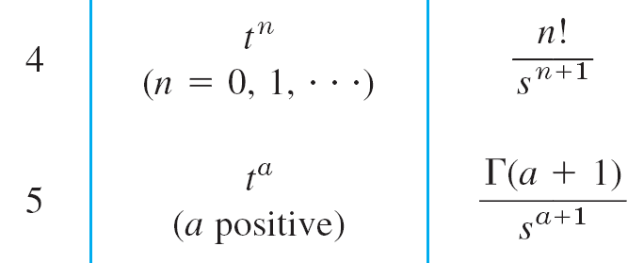

More examples:
>> laplace(x^sym(3/2),t)
??? Undefined function or variable 'x'.
>> syms
'ans'
>> syms x
>> laplace(x^sym(3/2),t)
??? Undefined function or variable 't'.
>> syms
'ans' 'x'
>> syms t
>> laplace(x^sym(3/2),t)
ans =
3/4*pi^(1/2)/t^(5/2)
f(t)=
F(s)=
f(x)=x^{3/2} → F(t) = Γ(3/2+1) / t^{(3/2+1)} where Γ is the Gamma
function defined as the following:

Slide 7
Inverse Laplace Transform
Examples:
syms s t w
ilaplace(1/(s-1))
ilaplace(1/(s^2+1))
ilaplace(s/(s^2 + w^2),s,t)
ilaplace(1/s,s,t)
ilaplace(exp(-2*s)/s,s,t)
All 2nd and 3rd arguments for ilaplace() are not really needed at all.

Slide 8
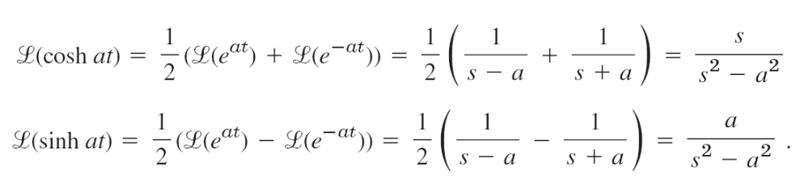
Examples shown in the textbook
Find the transforms of cosh at and sinh at.
Find the Laplace transform of
  f(t) = e^{−t}(3cos20t−7sin20t).
The inverse of this F(s)?

Slide 9
Example 1
Consider the initial value problem y” + 3y’ + 2y = e^{−t}, y(0) = 4 and y’(0) = 5.
Solution steps:
  Let f(t) be defined to the right-hand-side function.
  Use Laplace transform to convert f(t) to F(s).
  Perform Laplace transform on y”, y’ and y, incorporating the initial conditions. Note that y(t) becomes Y(s).
  From the resulting algebraic equation, solve for Y(s).
  Use inverse Laplace transform to get y(t) from Y(s).

Slide 10

Example 1 – cont’d
Consider the initial value problem y” + 3y’ + 2y = e^{−t}, y(0) = 4 and y’(0) = 5.
Part 1: 先求等號右邊的 laplace 轉換
Declaring that these variables are symbolic.
>> syms s t Y
>> f=exp(-t);
f =
exp(-t)
>> F=laplace(f,t,s)
F =
1/(1+s)
Perform the transform on the
non-homogeneous term first.

Slide 11
Example 1 – cont’d
(F)
Consider the initial value problem y” + 3y’ + 2y = e^{−t}, y(0) = 4 and y’(0) = 5.
Part 2:
These automatically make Y1 and Y2
symbolic, since Y and s are symbolic.
y’ ⇨ sY−y(0)
y” ⇨ s²Y−sy(0)−y’(0)
= s[sY−y(0)] −y’(0)
(s²+3s+2)Y=
(4s²+21s+18)/(s+1)
y(t) = −8e^{−2t} + 12e^{−t} + te^{−t}
>> Y1=s*Y-4;
>> Y2=s*s*Y-s*4-5;
>> Sol=solve(Y2+3*Y1+2*Y-F, Y)
Sol =
(21*s+4*s^2+18)/(1+s)/(3*s+2+s^2)
>> sol=ilaplace(Sol,s,t)
sol =
-8*exp(-2*t)+(12+t)*exp(-t)
>> ezplot(f,[0,10])
>> ezplot(sol,[0,10])

Slide 12
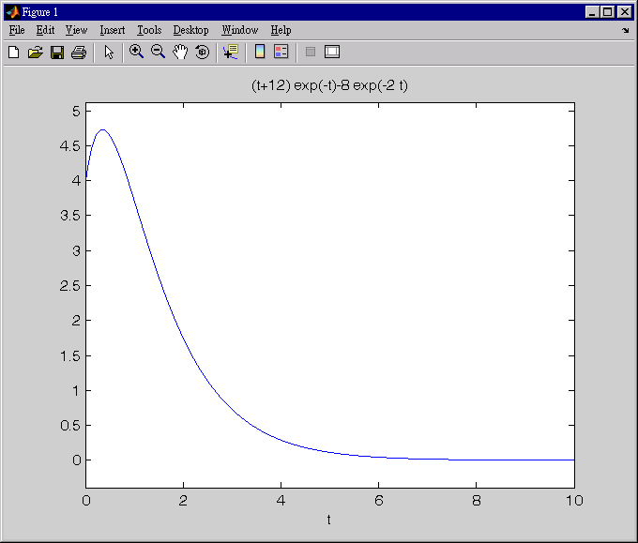
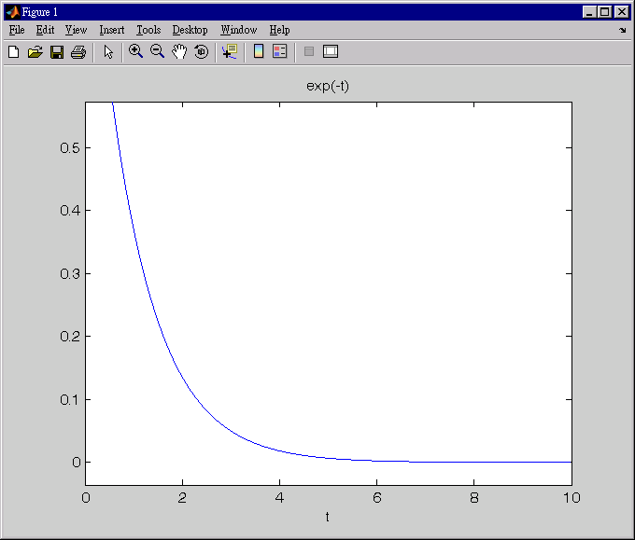
y(t) = −8e^{−2t} + 12e^{−t} + te^{−t}
Output from the system
f(t) = e^{−t}
Input to the system

Slide 13
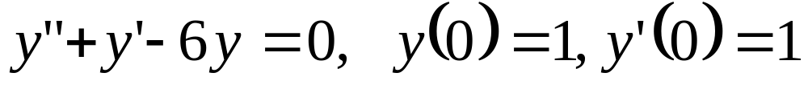

Slide 15
Example 2
Consider the initial value problem y” + 3y’ + 2y = f(t), y(0) = 2 and y’(0) = 3. f(t) = 1 for t < 3, t−2 for 3<t<6, and 2 for t > 6.
For the three segments of f(t), we have the function
represented by step function, respectively, as:
1 − u(t − 3) for t < 3,
(t − 2)*[u(t − 3)-u(t − 6)] for 3 < t < 6, and
2*u(t − 6) for t > 6
That is, f(t) = 1 − u(t − 3) + (t − 2)*[u(t − 3)-u(t − 6)] + 2*u(t − 6)

Slide 16
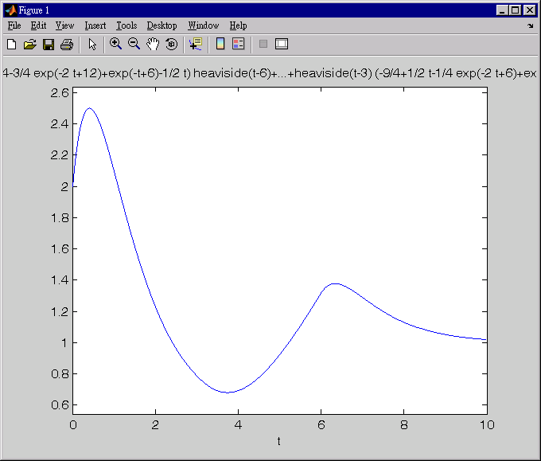
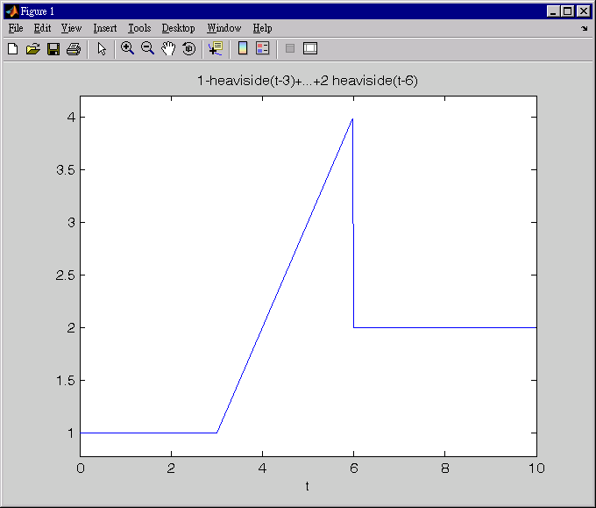
Output from the system
1 for t < 3,
t − 2 for 3 < t < 6,
2 for t > 6
Input to the system

